Slide 1
Bunch Detection using YOLO and FasterRCNN Deep Learning Algorithms
Master’s Degree in Computer Science and Engineering
Computer Vision & Deep Learning (2022/2023)
Davide Camponogara VR472108

Slide 2

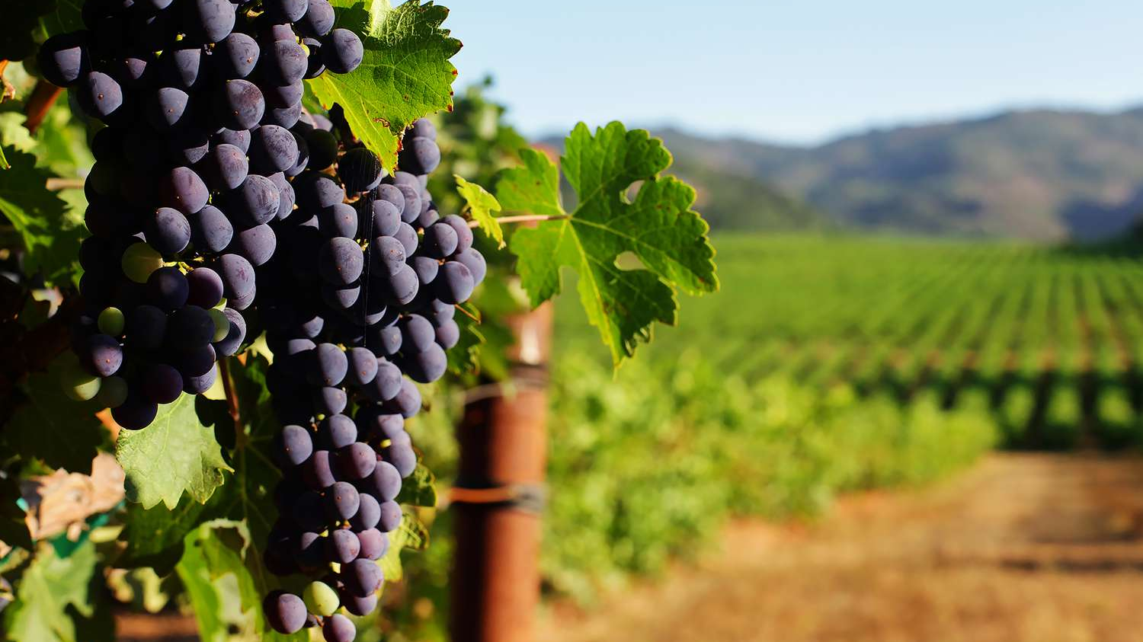
AI in viticulture
The use of artificial intelligence technologies in the agronomy is becoming always more important.
Deep neural network can now be trained on large datasets of many different types of crops, with excellent results.
Field owners can now monitor the health and growth of their land, increasing productivity.

Slide 3

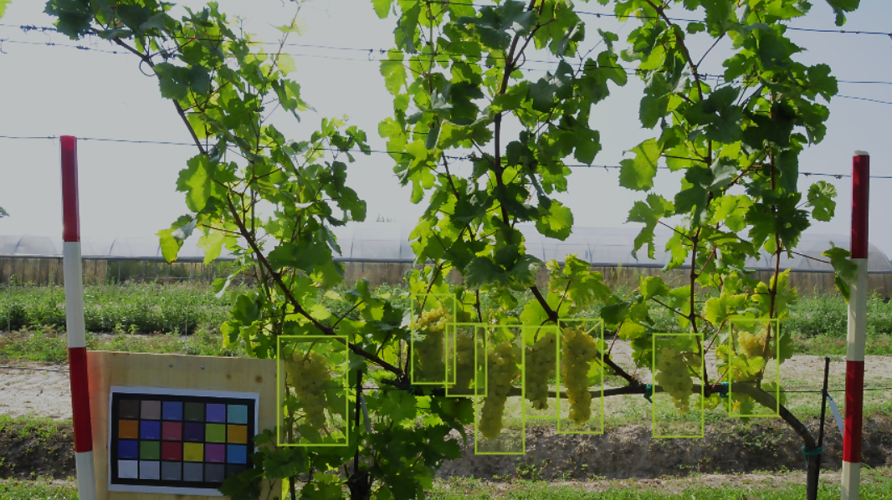
Object Detection in Our Project
The task of assigning a label and a bounding box to a objects in the image.
We compare the different results in bunch of grapes detection, using FasterRCNN and YOLO architectures.

